Slide 1
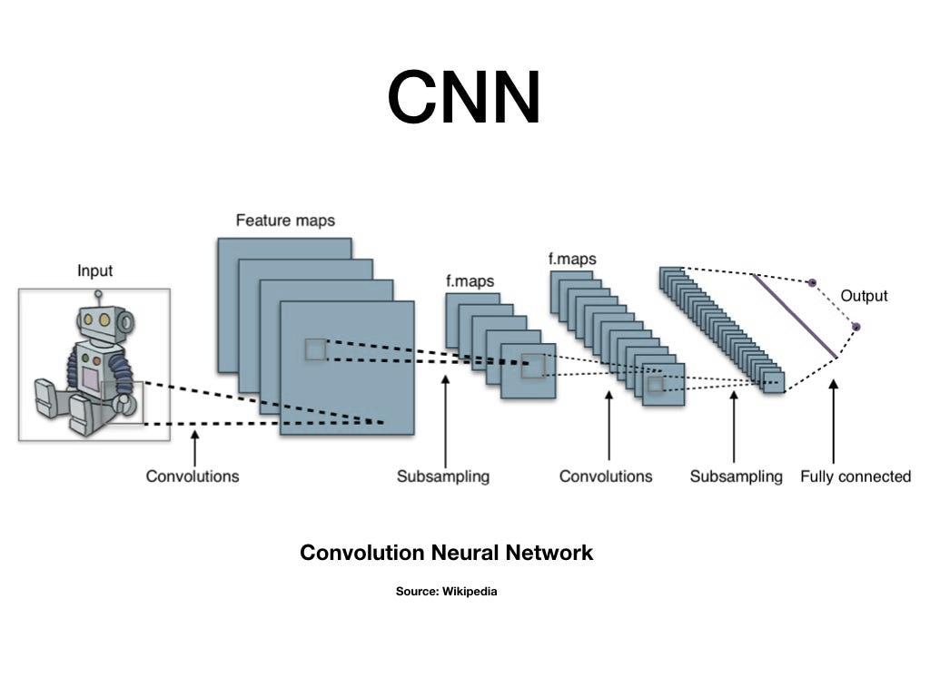
Group: 8
Comparison of CNN, EfficientNet, and VGG for Image Classification using Mpox dataset
01
02
03
04
05
06
Presenter: 013 Rahul Patil
054 Tanvi Mahajan
059 shivangni shree
070 deep nirheli
107 Pritam kolage
Introduction
This project explores the performance of three deep learning models—CNN, EfficientNet, and VGG—on image classification tasks. The goal is to compare their accuracy, efficiency, and computational cost. Deep learning plays a crucial role in various AI applications, and selecting the right model can significantly impact real-world implementations.

Slide 2

Group: 8
Comparison of CNN, EfficientNet, and VGG for Image Classification using Mpox dataset
Presenter: 013 Rahul Patil
054 Tanvi Mahajan
059 shivangni shree
070 deep nirheli
107 Pritam kolage
Introduction
This project explores the performance of three deep learning models—CNN, EfficientNet, and VGG—on image classification tasks. The goal is to compare their accuracy, efficiency, and computational cost. Deep learning plays a crucial role in various AI applications, and selecting the right model can significantly impact real-world implementations.
Importance of the Project
This project aims to:
Automate the image classification process
Reduce manual effort and human error
Compare different architectures to find the most suitable model
Provide insights into model performance based on accuracy, speed, and computational efficiency
Selecting the right model is essential for optimizing performance in real-world applications.

Slide 3
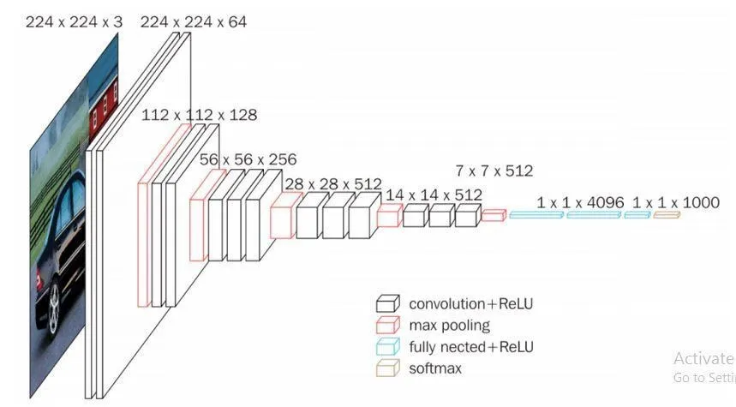
Introduction
This project explores the performance of three deep learning models—CNN, EfficientNet, and VGG—on image classification tasks. The goal is to compare their accuracy, efficiency, and computational cost. Deep learning plays a crucial role in various AI applications, and selecting the right model can significantly impact real-world implementations.
Importance of the Project
This project aims to:
Automate the image classification process
Reduce manual effort and human error
Compare different architectures to find the most suitable model
Provide insights into model performance based on accuracy, speed, and computational efficiency
Selecting the right model is essential for optimizing performance in real-world applications.
Overview of Models Used
Convolutional Neural Network (CNN):
EfficientNet:
A modern, optimized model designed to balance accuracy and efficiency, using an advanced scaling strategy.
A traditional deep learning model that extracts image features using convolutional layers.
VGG:
A deeper network with multiple convolutional layers, improving feature extraction but requiring more computational power.

Slide 4

Importance of the Project
This project aims to:
Automate the image classification process
Reduce manual effort and human error
Compare different architectures to find the most suitable model
Provide insights into model performance based on accuracy, speed, and computational efficiency
Selecting the right model is essential for optimizing performance in real-world applications.
Overview of Models Used
Convolutional Neural Network (CNN):
EfficientNet:
A modern, optimized model designed to balance accuracy and efficiency, using an advanced scaling strategy.
A traditional deep learning model that extracts image features using convolutional layers.
VGG:
A deeper network with multiple convolutional layers, improving feature extraction but requiring more computational power.
Dataset and Preprocessing
The dataset consists of labeled images categorized for training.
Images are preprocessed using:
Resizing to standard dimensions
Data Augmentation to improve generalization
Normalization for better model performance
The dataset is split into training and validation sets for evaluation..

Slide 5
Overview of Models Used
Convolutional Neural Network (CNN):
EfficientNet:
A modern, optimized model designed to balance accuracy and efficiency, using an advanced scaling strategy.
A traditional deep learning model that extracts image features using convolutional layers.
VGG:
A deeper network with multiple convolutional layers, improving feature extraction but requiring more computational power.
Dataset and Preprocessing
The dataset consists of labeled images categorized for training.
Images are preprocessed using:
Resizing to standard dimensions
Data Augmentation to improve generalization
Normalization for better model performance
The dataset is split into training and validation sets for evaluation..
Model Architectures
CNN Model:
Efficient-Net Model:
Uses multiple convolutional layers for feature extraction
Includes MaxPooling to reduce dimensionality
Ends with Dense layers for classification
Uses optimized scaling for better accuracy
More efficient and computationally lightweight compared to VGG
All models are trained over multiple epochs to optimize their accuracy.
Performance is evaluated using:
Accuracy: Measures correct predictions
Precision and Recall: Evaluate classification quality
Confusion Matrix: Visualizes true and false predictions
VGG Model:
Deeper architecture with more convolutional layers
Achieves higher accuracy but requires more computation

Slide 6
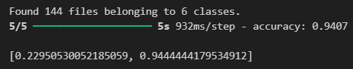
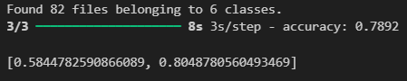
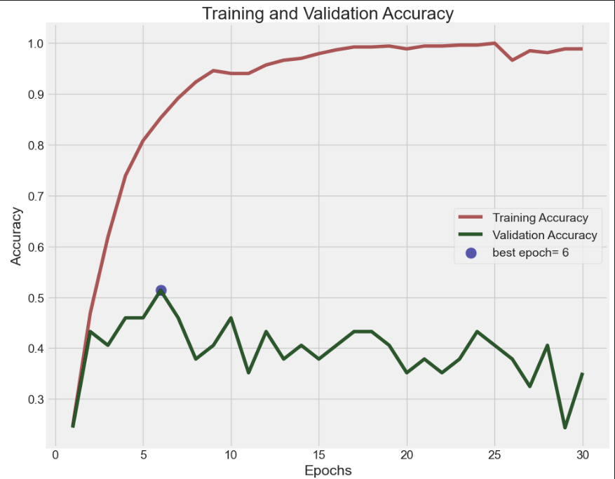
Dataset and Preprocessing
The dataset consists of labeled images categorized for training.
Images are preprocessed using:
Resizing to standard dimensions
Data Augmentation to improve generalization
Normalization for better model performance
The dataset is split into training and validation sets for evaluation..
Model Architectures
CNN Model:
Efficient-Net Model:
Uses multiple convolutional layers for feature extraction
Includes MaxPooling to reduce dimensionality
Ends with Dense layers for classification
Uses optimized scaling for better accuracy
More efficient and computationally lightweight compared to VGG
All models are trained over multiple epochs to optimize their accuracy.
Performance is evaluated using:
Accuracy: Measures correct predictions
Precision and Recall: Evaluate classification quality
Confusion Matrix: Visualizes true and false predictions
VGG Model:
Deeper architecture with more convolutional layers
Achieves higher accuracy but requires more computation
Prediction Accuracy and Capabilities
CNN Accuracy: 89% (performs well but may require fine-tuning)
VGG Accuracy: 96% (high accuracy but computationally expensive)
EfficientNet Accuracy: 94% (optimized for high accuracy and efficiency)
Strengths and Weaknesses:
CNN is simple but may lack deep feature extraction.
VGG achieves great results but is computationally heavy.
EfficientNet balances accuracy and efficiency, making it a strong candidate for real-world applications.

Slide 7
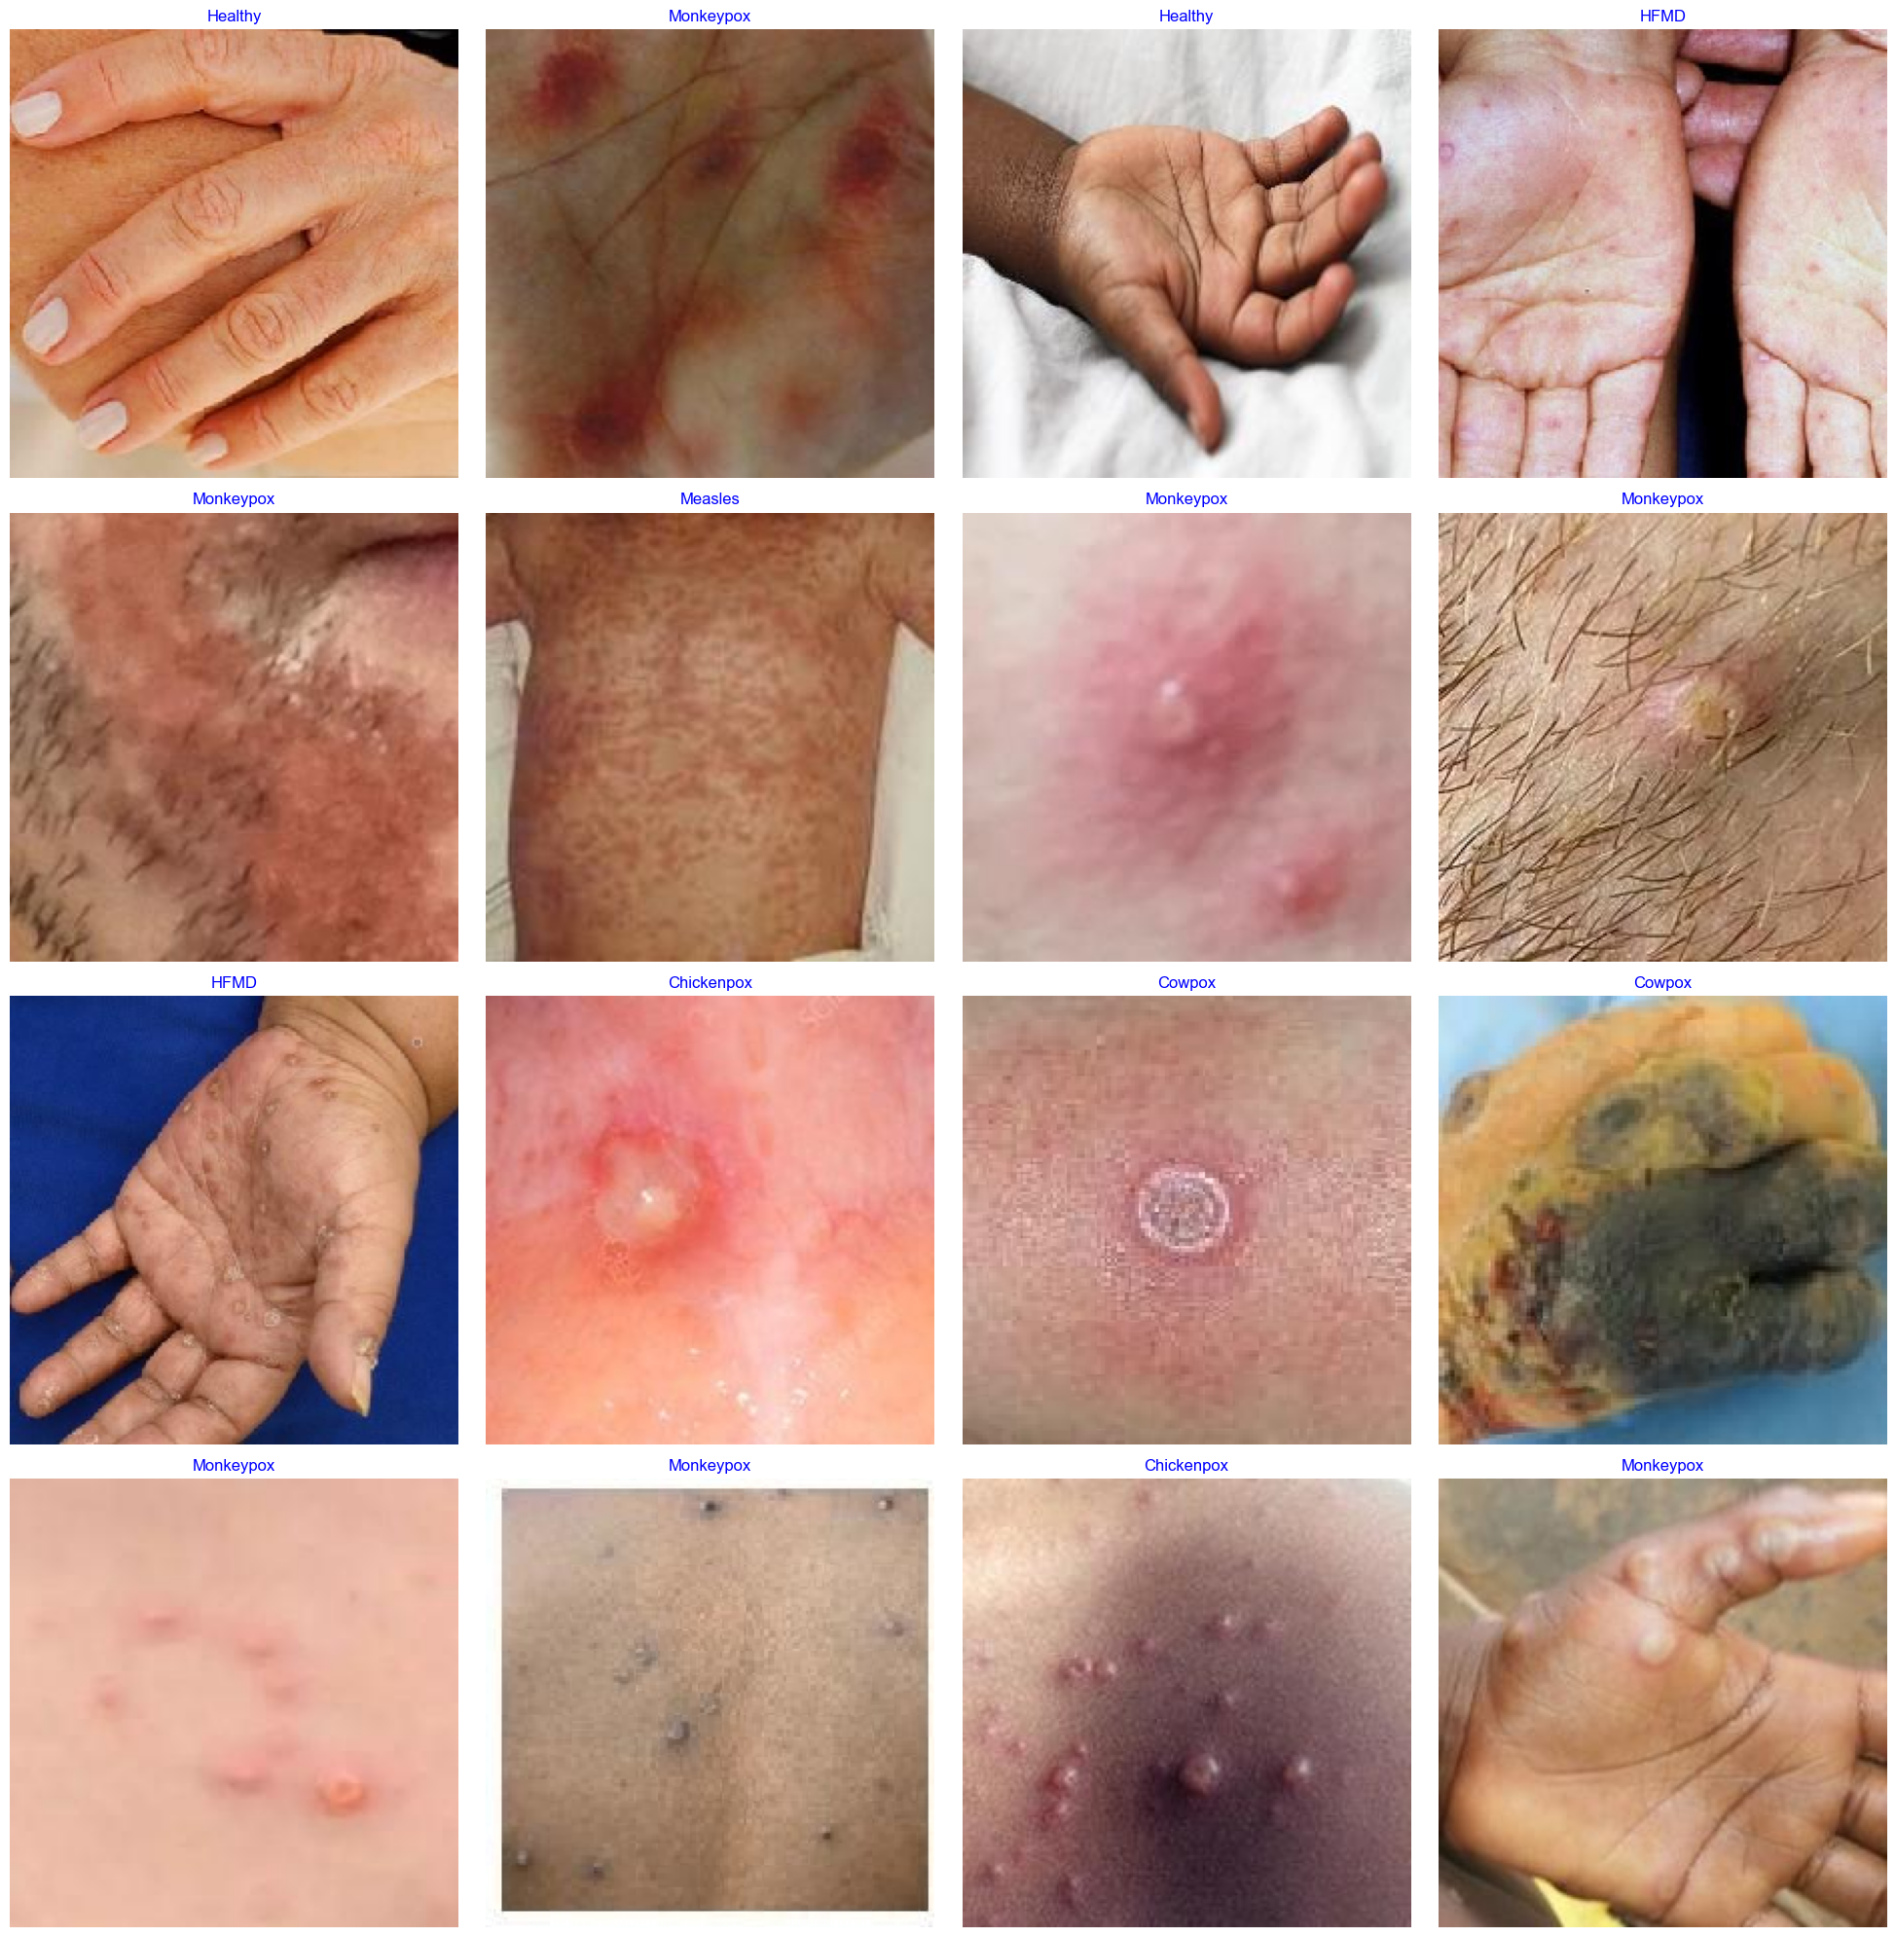
Model Architectures
CNN Model:
Efficient-Net Model:
Uses multiple convolutional layers for feature extraction
Includes MaxPooling to reduce dimensionality
Ends with Dense layers for classification
Uses optimized scaling for better accuracy
More efficient and computationally lightweight compared to VGG
All models are trained over multiple epochs to optimize their accuracy.
Performance is evaluated using:
Accuracy: Measures correct predictions
Precision and Recall: Evaluate classification quality
Confusion Matrix: Visualizes true and false predictions
VGG Model:
Deeper architecture with more convolutional layers
Achieves higher accuracy but requires more computation
Prediction Accuracy and Capabilities
CNN Accuracy: 89% (performs well but may require fine-tuning)
VGG Accuracy: 96% (high accuracy but computationally expensive)
EfficientNet Accuracy: 94% (optimized for high accuracy and efficiency)
Strengths and Weaknesses:
CNN is simple but may lack deep feature extraction.
VGG achieves great results but is computationally heavy.
EfficientNet balances accuracy and efficiency, making it a strong candidate for real-world applications.
Conclusion and Future Work
The project successfully compared CNN, VGG, and EfficientNet models.
Key Insights
VGG offers high accuracy but is resource-intensive.
EfficientNet provides a balance of accuracy and computational efficiency.
Future Work
Using more complex datasets
Hyperparameter tuning for better results
Exploring real-world deployment possibilities

Slide 8

Prediction Accuracy and Capabilities
CNN Accuracy: 89% (performs well but may require fine-tuning)
VGG Accuracy: 96% (high accuracy but computationally expensive)
EfficientNet Accuracy: 94% (optimized for high accuracy and efficiency)
Strengths and Weaknesses:
CNN is simple but may lack deep feature extraction.
VGG achieves great results but is computationally heavy.
EfficientNet balances accuracy and efficiency, making it a strong candidate for real-world applications.
Conclusion and Future Work
The project successfully compared CNN, VGG, and EfficientNet models.
Key Insights
VGG offers high accuracy but is resource-intensive.
EfficientNet provides a balance of accuracy and computational efficiency.
Future Work
Using more complex datasets
Hyperparameter tuning for better results
Exploring real-world deployment possibilities
References
Dataset Link:
https://www.kaggle.com/datasets/joydippaul/mpox-skin-lesion-dataset-version-20-msld-v20
Desing Thinking:
https://github.com/poojasrini/Image-classification-using-KNN/blob/main/Image_Classification.ipynb
Reference Codes:
https://www.kaggle.com/code/mohitkhatrii/vgg16v2-tuned
https://www.youtube.com/watch?v=9GzfUzJeyi0
Thank You!

Slide 9
Conclusion and Future Work
The project successfully compared CNN, VGG, and EfficientNet models.
Key Insights
VGG offers high accuracy but is resource-intensive.
EfficientNet provides a balance of accuracy and computational efficiency.
Future Work
Using more complex datasets
Hyperparameter tuning for better results
Exploring real-world deployment possibilities
References
Dataset Link:
https://www.kaggle.com/datasets/joydippaul/mpox-skin-lesion-dataset-version-20-msld-v20
Desing Thinking:
https://github.com/poojasrini/Image-classification-using-KNN/blob/main/Image_Classification.ipynb
Reference Codes:
https://www.kaggle.com/code/mohitkhatrii/vgg16v2-tuned
https://www.youtube.com/watch?v=9GzfUzJeyi0
Thank You!

